Slide 1



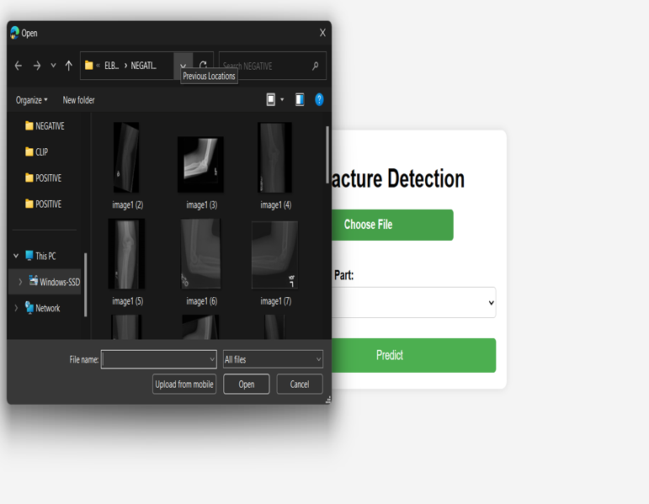
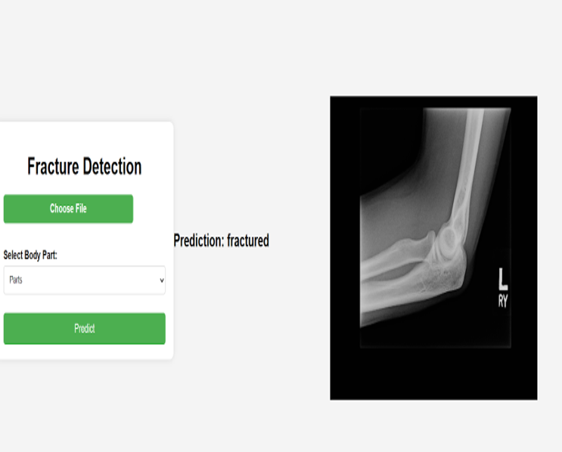
X-Ray Analysis of Palm and Fingers for Fracture Detection
Department of Computer Science & Engineering
School of Computing
10214CS602 – MINOR PROJECT
WINTER SEMESTER 2023-2024
ABSTRACT
INTRODUCTION
RESULTS
STANDARDS AND POLICIES
The majority of bones that have fractured in humans are hand bones. As we use our hands widely, they need early and accurate detection to be diagnosed. Fractures in the hands are most frequently brought on by blunt force trauma, sports injuries, and bone fragility. Getting an X-ray of the affected area of the bone and then discussing the results with a medical practitioner or radiologist is the standard procedure for determining whether or not a fracture exists in the bone. The majority of medical professionals and radiologists use X-rays to diagnose hand fractures; however, in some instances, they might miss small or hairline fractures. Additionally, it might be difﬁcult to ﬁnd a good radiologist who can detect the fracture properly and in time, because a delay in diagnosis can cause the injury to be more severe, and the bone might not be recovered properly
X-ray analysis of the palm and fingers is a critical diagnostic tool in medical imaging, providing high-resolution visualization of hand structures for the assessment of fractures and other bone-related injuries. This method employs electromagnetic radiation to produce images of the skeletal anatomy, offering detailed insights into the integrity and alignment of the bones, as well as potential soft tissue damage. Through a series of standard views, including anteroposterior, oblique, and lateral projections, clinicians can identify and classify fractures based on their location, type, and severity.The use of X-ray analysis facilitates accurate diagnosis, informed treatment planning, and effective monitoring of healing progress. With advances in imaging technology, such as digital X-rays and 3D reconstruction, the quality and precision of these analyses continue to improve.Computer aided diagnosis (CAD) is a computer-based technology for clinicians to reduce their workload and improve their efficiency. In medical image analysis, CAD helps clinicians with suggestions made by algorithms in tasks of classification, detection and segmentation. Radiologists diagnose various fractures through visual inspection of X-ray radiographs, which is a time-consuming and laborious process.
Fracture detection is a critical process across various industries, essential for ensuring structural integrity and safety. Employing advanced techniques such as ultrasonic testing, radiographic imaging, and magnetic particle inspection, professionals meticulously analyze materials and components for any signs of fracture or weakness. These methods adhere to rigorous standards set forth by organizations like ASTM International, guaranteeing consistency and reliability in detection procedures. With a focus on precision and accuracy, trained personnel meticulously document their findings, adhering to regulatory requirements and quality management systems
Standards and policies for fracture detection are pivotal across industries, guiding the implementation of reliable methodologies to identify potential structural weaknesses. These standards, often industry-specific, serve as benchmarks established by regulatory bodies like NASA, the FDA, or API, ensuring compliance with safety and quality requirements. Non-destructive testing (NDT) methods, including ultrasonic and radiographic techniques.
CONCLUSIONS
The main agenda of the project to save the during the time of the critical situation. The detection of organ dysfunction using machine learning through Convolutional Neural Networks (CNNs) has the capacity to study the x-ray and gives the most accurate results by this algorithm and the accuracy and timeliness of organ dysfunction detection and AKI prediction, leading to improved patient outcomes and reduced healthcare costs. CNNs are known for their robustness in handling complex data structures, making them suitable for detecting organ dysfunction in various medical scenarios. By this we can conclude Detection of Orgon Dysfunction using ML through CNNs have demonstrated superior performance in detecting organ dysfunction compared to traditional methods.
Diagnosing a child X-ray, complex osteoporosis and bone tumour case remains as an intellectual challenge for the radiologist. It is difficult to analyse when the situation is complex and machines canassist a radiologist in proper diagnosis and can draw their attention to an ignored or complex case. For example, in the case of osteoporosis, machines can predict that this condition can lead to fracture inthe future and precautions are to be taken. Another case is the paediatric x-rays, the bones of a child
in the growing stage till the age of 15–18 years.
TEAM MEMBER DETAILS
METHODOLOGIES
1. Vtu23983/B.YASWANTH KUMAR REDDY
2. Vtu23998/V.VENKATARAO
3. Vtu24052/SAI SANDEEP
1. 7995148869
2. 7702468734
3. 7702894785
1. vtu23983@veltech.edu.in
2. vtu23998@veltech.edu.in
3. vtu24052@veltech.edu.in
Step 1: Data collection and manipulation
Step 2: Convolutional Neural Networks(CNNs) algorithm
Step 3: Imaging techniques.
Step 4: Ultrasound
Step 5: Advanced imaging techniques
Step 6: Clinical examination
Fig-1 upload the x-ray analysis image
ACKNOWLEDGEMENT
Supervisor Name :Dr.M.Saravana Karthikeyan M.E.,Ph.D.,
ASSISTANT PROFESSOR-SENIOR GRADE
Phone Number: 9443852472
Email:sarvanakarthikeyan@veltech.edu.in
Fig-2 predicted output

